Slide 1
Walmart Sales Dashboard – Kaggle Dataset
Interactive dashboard using Power BI

Slide 2
Dataset Overview
Dataset Description
Content:
Data source: Walmart Sales Dataset (Kaggle)
Time period: 2010 to 2012
Total columns used:
  Store
  Date
  Weekly_Sales
  Holiday_Flag
  Temperature
  Fuel_Price
  CPI
  Unemployment
Purpose of dataset:
  Analyze store performance
  Study effect of holidays, temperature, fuel price, economic indicators on sales

Slide 3
Project Objective & Key Metrics
Objective:
To design an interactive dashboard providing insights into Walmart sales trends, store performance, and key influencing factors.
KPIs Created:
Total Weekly Sales
Highest Sales Week
Average Weekly Sales
Number of Stores

Slide 4
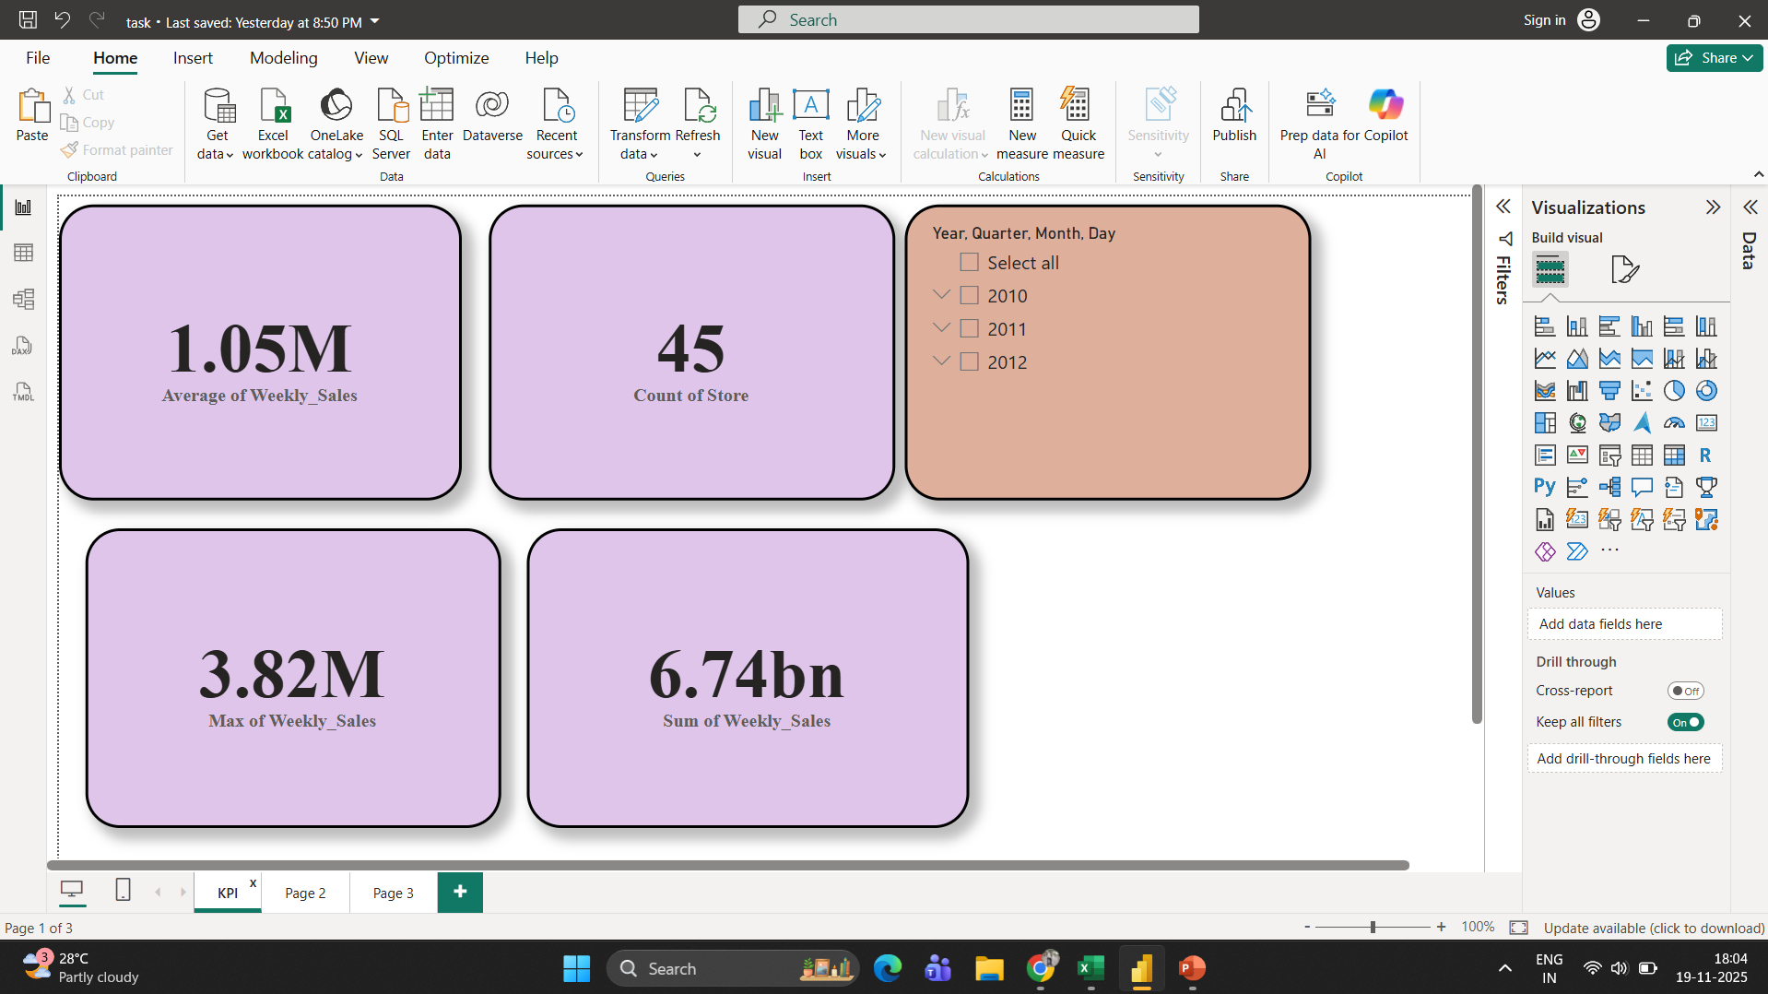

Slide 5
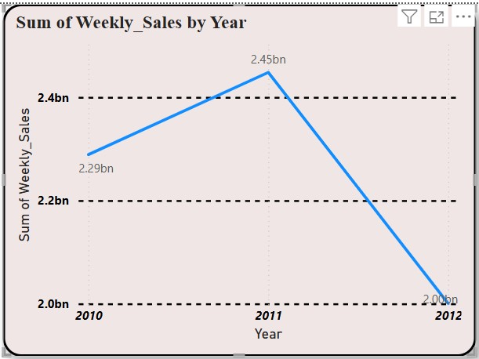
Sales Trend Analysis
Sum of Weekly Sales by Year (Line chart)
Sales increased from 2010 (2.29bn) to 2011 (2.45bn).
There is a decline in 2012 (2.03bn).
2011 recorded the highest sales during the 3-year period.
This indicates strong growth in 2011 followed by a slowdown.

Slide 6
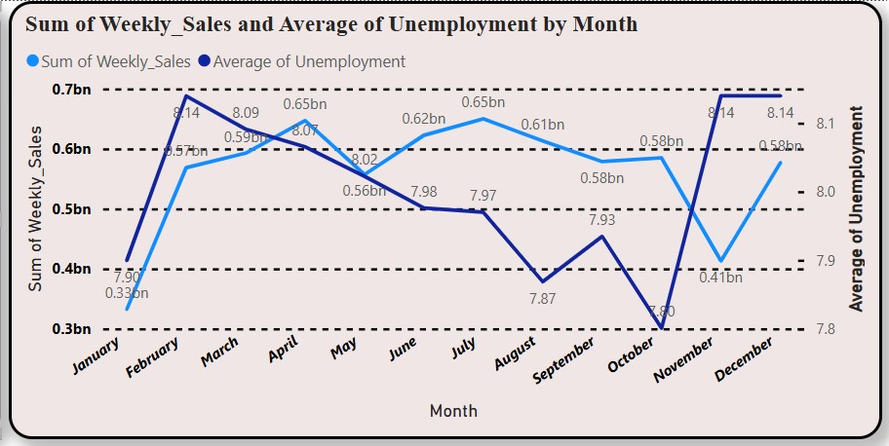
Sales Trend Analysis
Sum of Weekly Sales + Average Unemployment by Month (Dual-Line Chart)
Sales peak in February and March.
A noticeable decline in sales is seen from July to September.
Sales rise again in November and December (holiday season).
Unemployment drops when sales increase, showing an economic relationship.
When unemployment rises (e.g., October), sales drop.

Slide 7
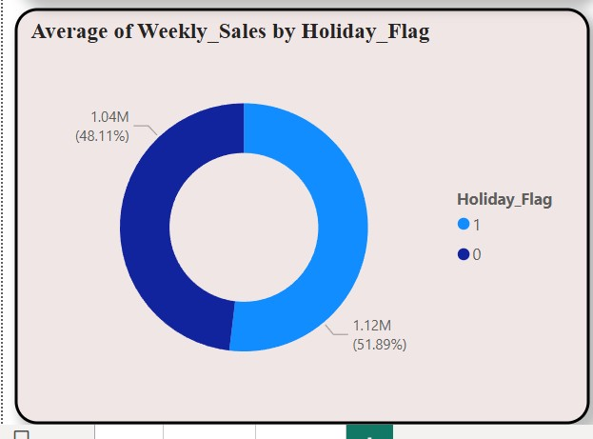
Donut Chart – Average Weekly Sales by Holiday Flag
Average Weekly Sales: Holiday vs Non-Holiday Weeks:
The donut chart shows the difference in average weekly sales between holiday and non-holiday weeks.
Holiday weeks contribute ₹1.12M (approx 51.88%).
Non-holiday weeks contribute ₹1.04M (approx 48.12%).
This indicates that holiday periods result in higher customer spending, slightly boosting weekly sales.

Slide 8
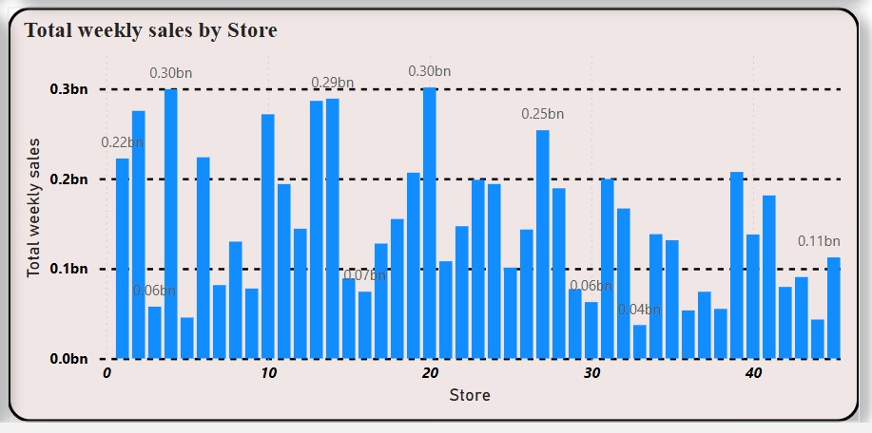
Cluster Column Chart – Total Weekly Sales by Store
Store-wise Total Weekly Sales Analysis:
This bar chart shows the total weekly sales across all stores (1 to 45).
Some stores (e.g., Store 20, 4, 14)* have consistently higher weekly sales, indicating strong demand or larger customer base.
The chart helps identify top-performing and underperforming stores.

Slide 9
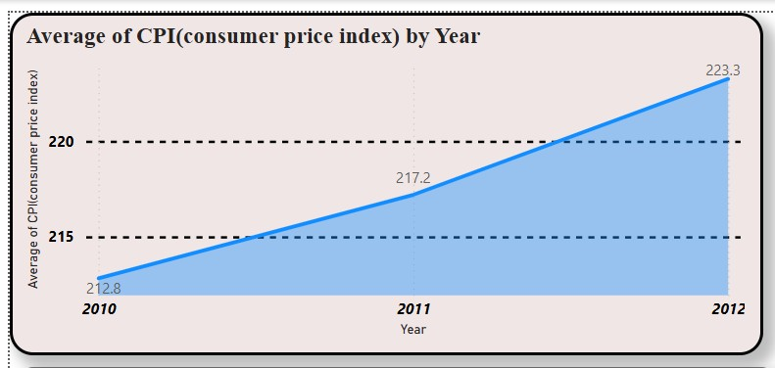
Consumer Price Index (CPI) Trend Analysis (2010–2012)
Key Observations (Area Chart) :
CPI was highest in 2010 (228.8) indicating high inflation.
CPI dropped in 2011 (212.2) showing improved economic stability.
CPI slightly decreased again in 2012 (223.3).
Overall, inflation decreased over the years, which may have contributed to improved sales trends.

Slide 10
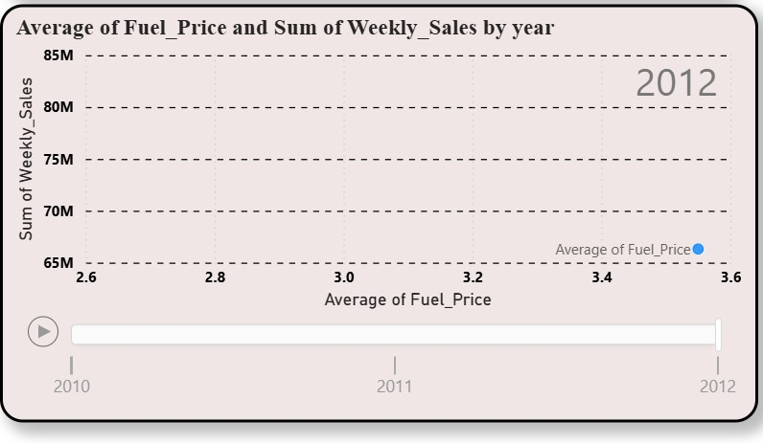
External Factors Impacting Weekly Sales (Scatter Chart Analysis)
Scatter Chart: Average Fuel Price vs Weekly Sales.
The scatter chart shows how changes in average fuel price correlate with weekly sales across the years.
When fuel prices are higher, weekly sales tend to slightly decrease.
Lower fuel prices indicate better affordability for customers which may help store visits and weekly sales.
As the year progresses (2010 → 2011 → 2012), the position of the points changes slightly, indicating annual variation in fuel cost and consumer spending patterns.
Key Insight:
✔ Higher fuel prices may reduce customer store visits and impact weekly sales negatively.

Slide 11
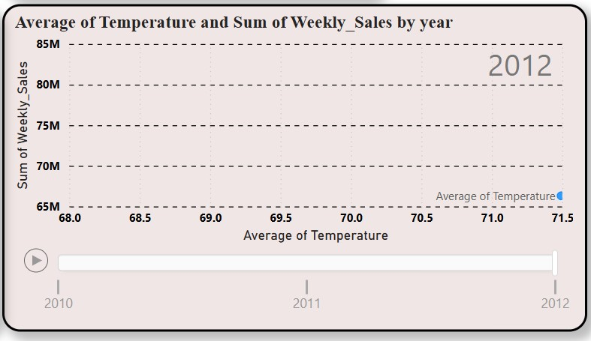
External Factors Impacting Weekly Sales (Scatter Chart Analysis)
Relationship Between Temperature and Weekly Sales
This scatter chart compares average temperature with weekly sales over the years.
When temperature increases, weekly sales show slight variations, suggesting that sales may decline during very hot weeks.
Cooler weeks generally align with higher weekly sales, likely due to increased customer comfort and movement.
The yearly animation (2010–2012) shows how temperature shifts influence the distribution of sales points.

Slide 12
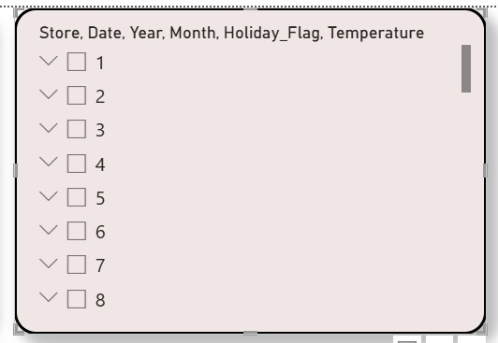
Interactive Slicer for Dynamic Filtering
Description:
This slicer provides an interactive way to filter the dashboard by different attributes such as Store, Date, Year, Month, Holiday Flag, Temperature, Fuel Price, CPI, and Unemployment. Selecting any of these options instantly updates all charts, allowing the user to analyze specific stores, compare years, or focus on key economic factors.
Key Insights:
Allows quick comparison of different stores
Helps analyze specific months or years
Supports holiday vs non-holiday sales analysis

Slide 13
Conclusion:
The analysis of the Walmart sales dataset revealed clear patterns in store performance, seasonal trends, and external economic influences. Sales peaked in 2011 and were strongly affected by holidays, temperature changes, and fuel prices. Store-wise comparison highlighted significant performance differences, helping identify high- and low-performing stores. Economic indicators like CPI and unemployment showed a noticeable impact on customer spending. Overall, the interactive dashboard provides valuable insights that can support data-driven decisions to improve sales strategies and operational planning.

Slide 14
Thank You

